Slide 1
Final Project: CO2 Emissions
By: Adam Willoughby, Shayan Ali, and Charles Thomas Young IV

Slide 2
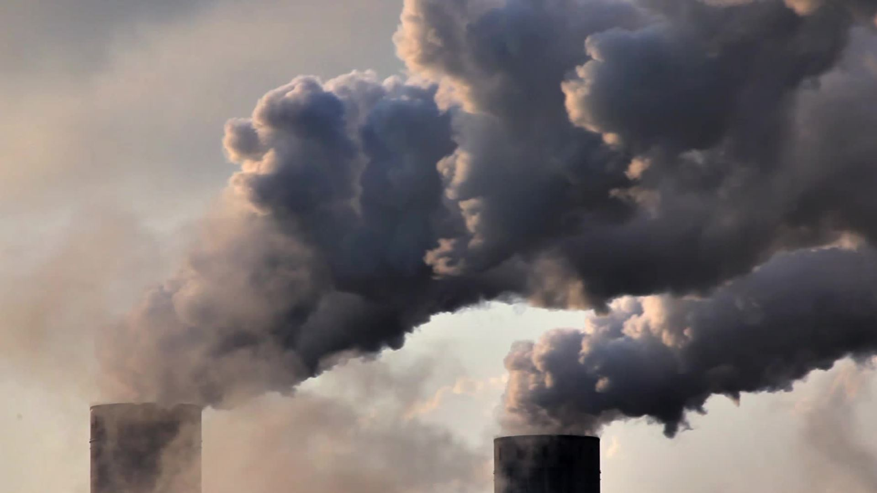
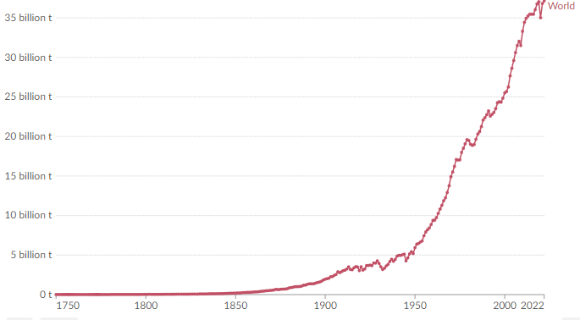
Problem: Rise of CO2 Emissions
In 2022 37.15 Billion tons of CO2 were emitted into the atmosphere
Earth's average surface temperature in 2022 was 1.55° F above the average 20th-century avg of 57.0° F
Sea level has risen 8-9 Inches from melted glaciers
Notes:
Say the problem, read out the statistics and Explain how this issue is a critical challenge for sustainable development and affects ecosystems, human health, and economies worldwide.

Slide 3
What causes the most Emission?
Humans
87% Burning of fossil fuels
9% Clearing forests (15 billion trees/year)
4% Industrial processes
Notes:
Other than natural CO2 emission like decomposition, HUMANS are the number 1 cause (read statistics), all starting back when the industrial revolution happened,

Slide 4
Research Question
"How have global CO2 emissions changed over time, what do the top producers all have in common, and what do these changes tell us about how well our environmental policies are working?"

Slide 5
Related Work on Solving the Issue
Green New Deal
Call for public policy to address climate change along with achieving other social aims like job creation, economic growth and reducing economic inequality.
Create more renewable energy like Solar and Wind

Slide 6
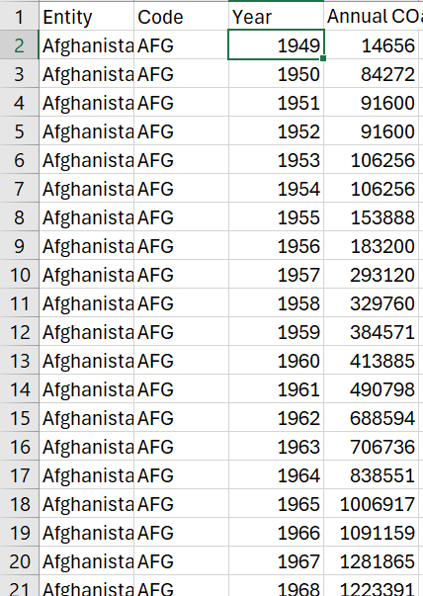
DATA
Data spans across all countries from the starting of their recording till 2022 showing the annual CO2 Emissions for that year.
Also has data on how much Low to High income countries produce CO2 (Based off World Bank)
From "Our World in Data", an organization that updates on CO2 emissions and various climate change metrics.

Slide 7
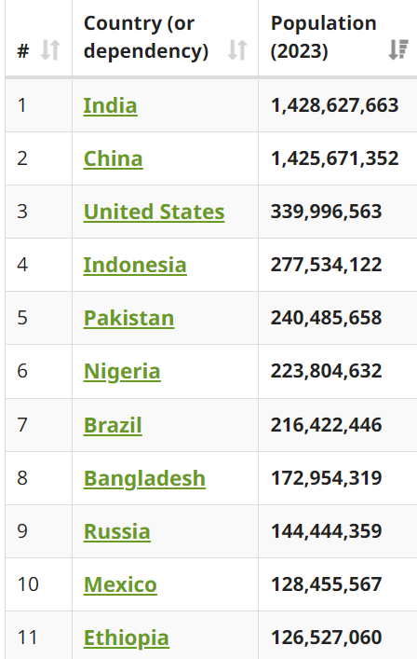
DATA
From WorldOmeter
Shows the population of every country in the world

Slide 8
Our Method/ Approach
Analyze our initial dataset
Make inferences based on the different kinds of CO2 emission levels
Look at where data drops or picks up
Create/find relationships in the data
Make our Visualizations
Do basic research based on the inferences or relationships

Slide 9
Results 1950-2022

Slide 10
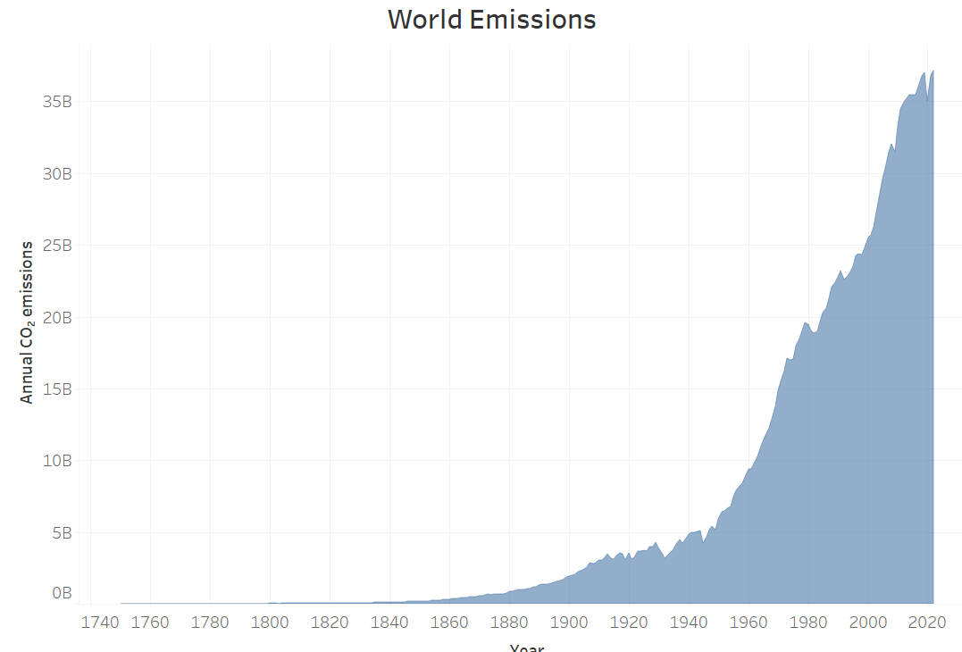
Since 1950 the WORLD has seen an increase in CO2 Emissions by 527%​

Slide 11
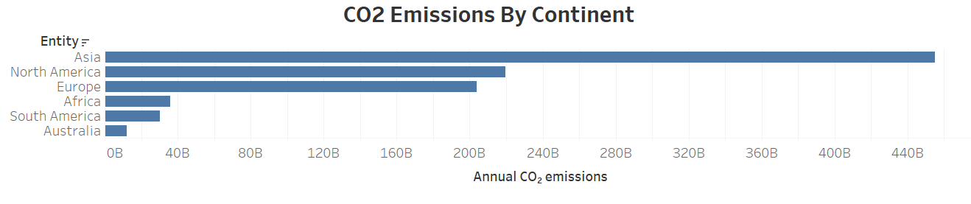
Asia: 5,336%
North America: 129%
Europe: 114%

Slide 12
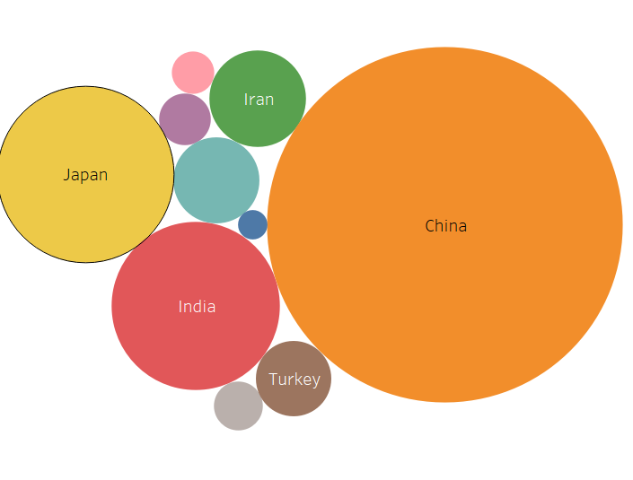
Asia 2022: 21.772 Billion Tons
China 2022: 11.396 Billion Tons
52.3% CO2 Emission Share

Slide 13
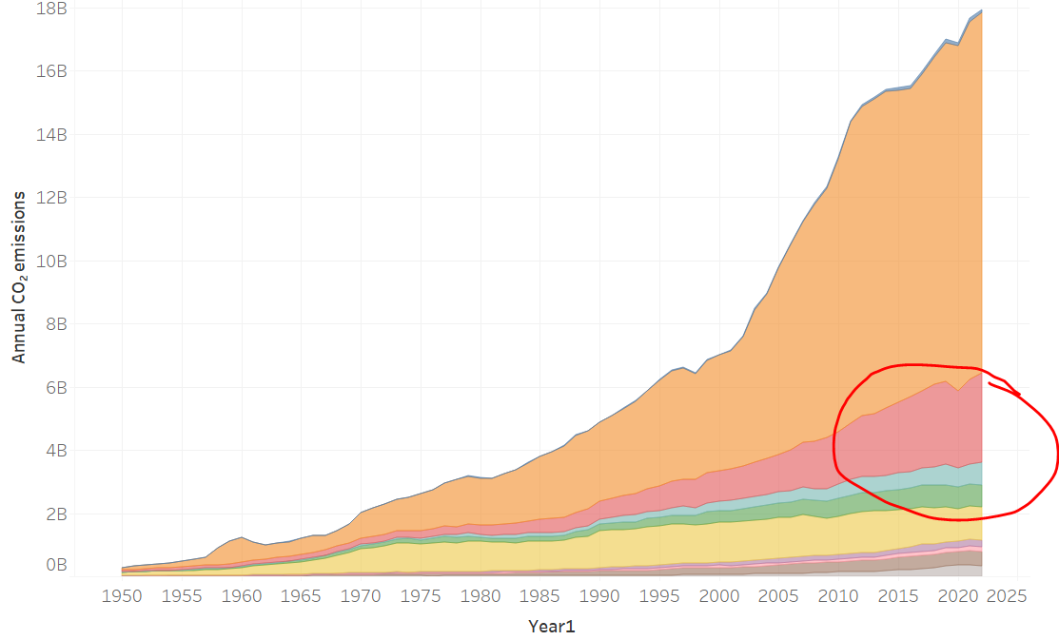
India comes in 2nd, holding a 12% share in the continent

Slide 14
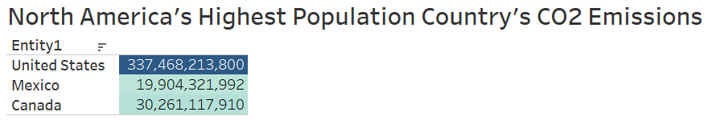

1950-2022

Slide 15
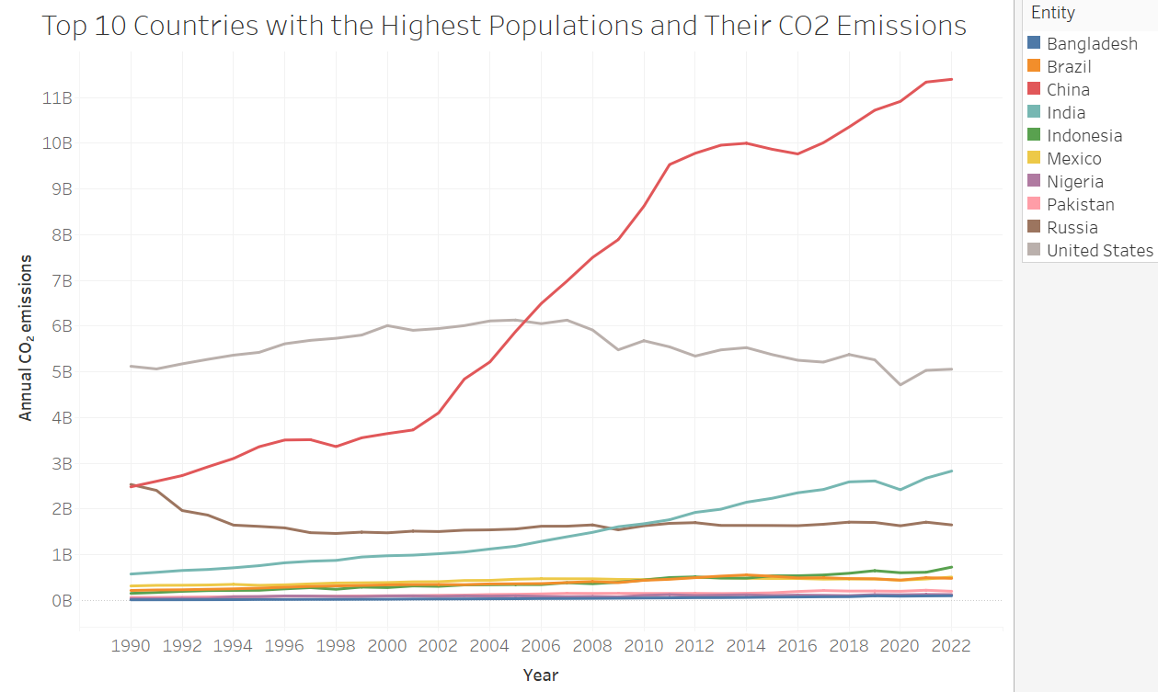
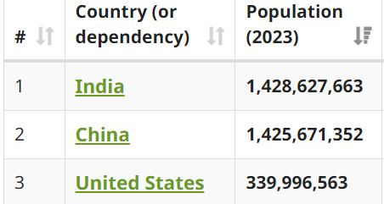




Slide 16
What do they all have in common?
Top 3 users of Coal
Top 3 for the generation of Electricity and Energy usage
Top 3 in Population
Notes:
Other than natural CO2 emission like decomposition, HUMANS are the number 1 cause (read statistics), all starting back when the industrial revolution happened,

Slide 17
Trends in the Data

Slide 18
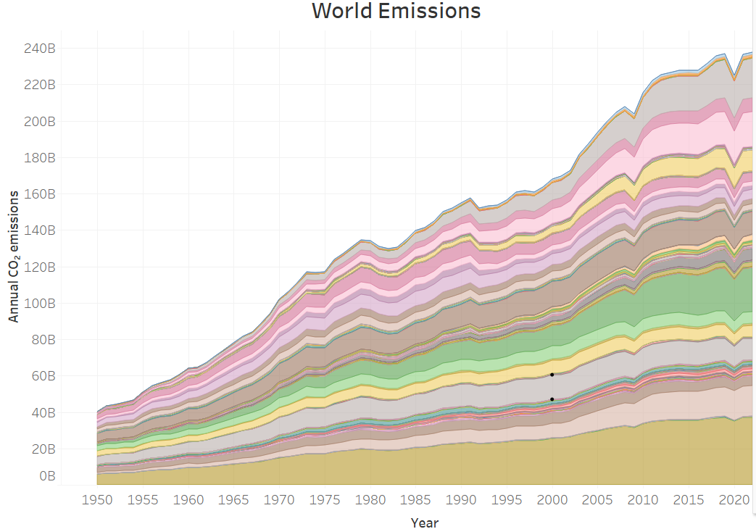
1979-1983: Gas price surge
1992: Kyoto Protocol
2009: Swin-flu
2020: Covid-19
Notes:
1992 - that commits state parties to reduce greenhouse gas emissions, based on the scientific consensus that global warming is occurring and that human-made CO2 emissions are driving it.
1979-1983 :
1978: $0.65 ($2.99 inflation-adjusted)
1979: $0.88 ($3.70 inflation-adjusted)
1980: $1.22 ($4.51 inflation-adjusted)
1981: $1.35 ($4.46 inflation-adjusted)
1982: $1.28 ($3.90 inflation-adjusted)
1983: $1.23 ($3.62 inflation-adjusted)
1984: $1.20 ($3.39 inflation-adjusted)

Slide 19
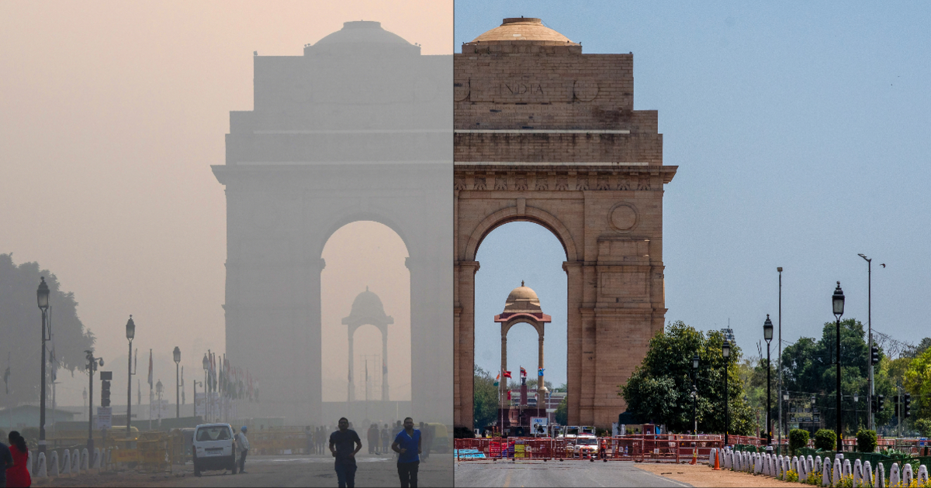

Slide 20
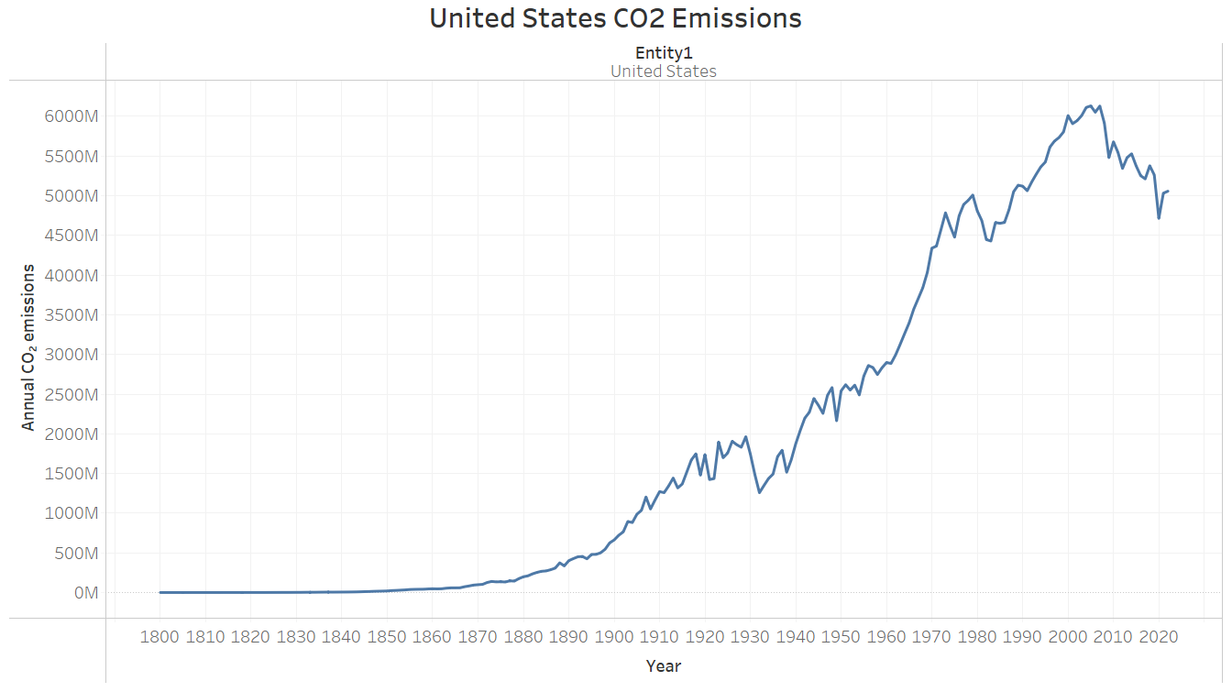
Green New Deal signed in 2007
(Increase in Solor and Wind energy)

Slide 21
Conclusion

Slide 22
Statistics
Takeaways
World emissions up 527% since 1950
Asia's emissions up +5000%
China accounts for 30% of the CO2 Emissions worldwide in 2022
87% of emissions are due to burning fossil fuels
World Emissions will continue to rise
Countries with the highest population will produce the most CO2 due to energy consumption
China is the #1 producer BY FAR
Fossil fuels continue to be the #1 lead for emissions
Dropped emissions were apart of World Wide shutdowns or a bad Economy
Green New Deal seems to be doing it's job on reducing CO2 Emissions

Slide 23
Future Work

Slide 24
Look into more Data pick ups/drop offs
Continue to analysis more data but would focus only on the top 10 CO2 contributors
Study their data on where things pick up and drop off
Devise a plan to help reduce emissions based off the data

